Slide 1
Music Recommendation System
Using Spotify
Web API
Siyeon Park, Isabella Francesconi

Slide 2
Table of contents
01
02
03
04
05
06
Introduction
Methodology
Our Data
Machine Learning
Conclusions
Work Division

Slide 3
01
Introduction

Slide 4
Why Music Recommendations?
Music is an essential part of daily life. As music industry thriving, sometimes users are overwhelmed with massive amounts of songs and artist, making it challenging to discover new music that perfectly aligns their music taste.
Our project aim is based on a personalizing music recommendation system, which work closely with data science as we need to access the music data.

Slide 5
2
Methodology

Slide 6
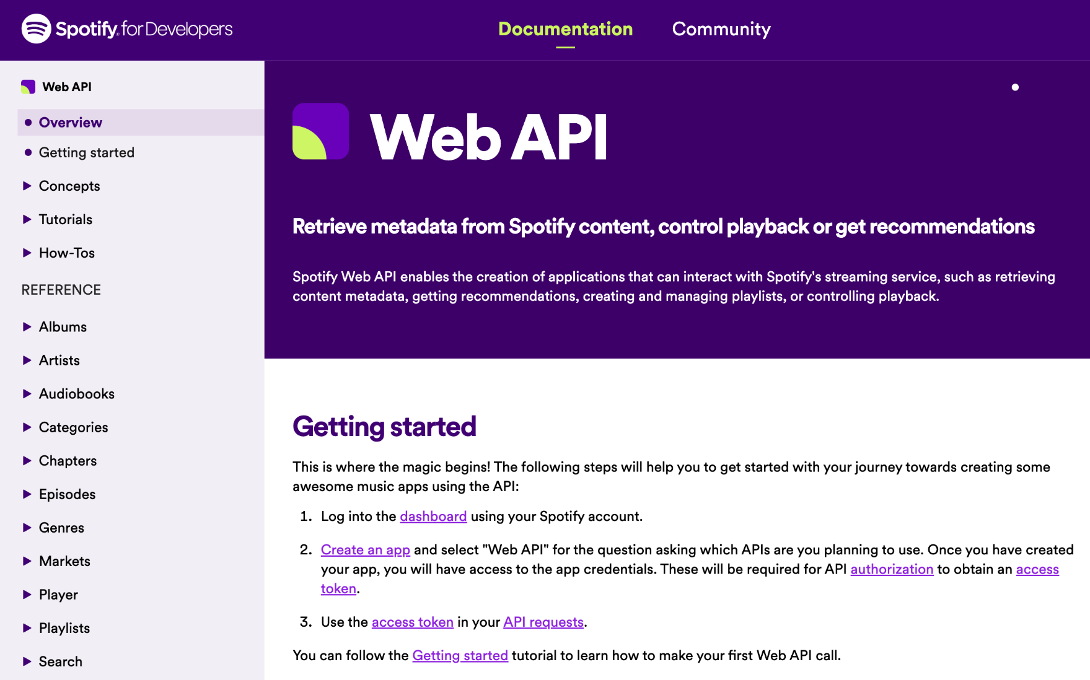
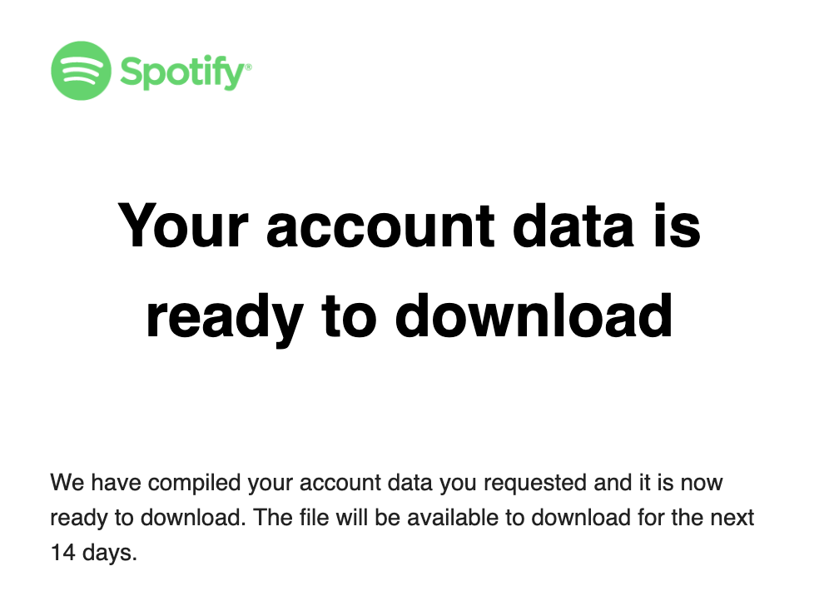
Methodology
Spotify Web API
Spotify Data
Notes:
How web api had different

Slide 7
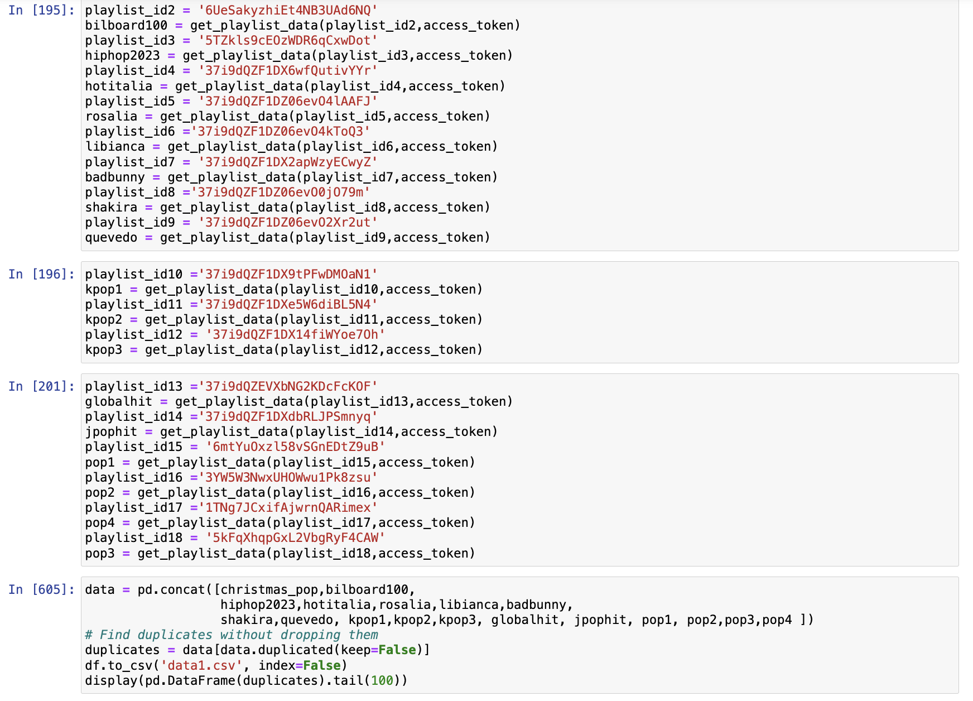
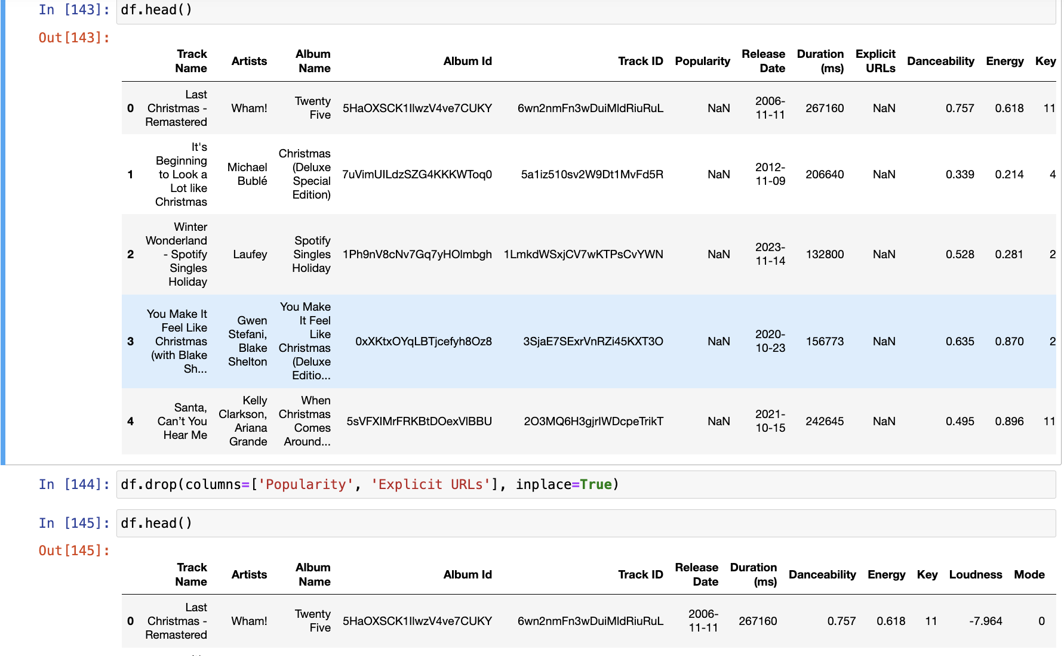
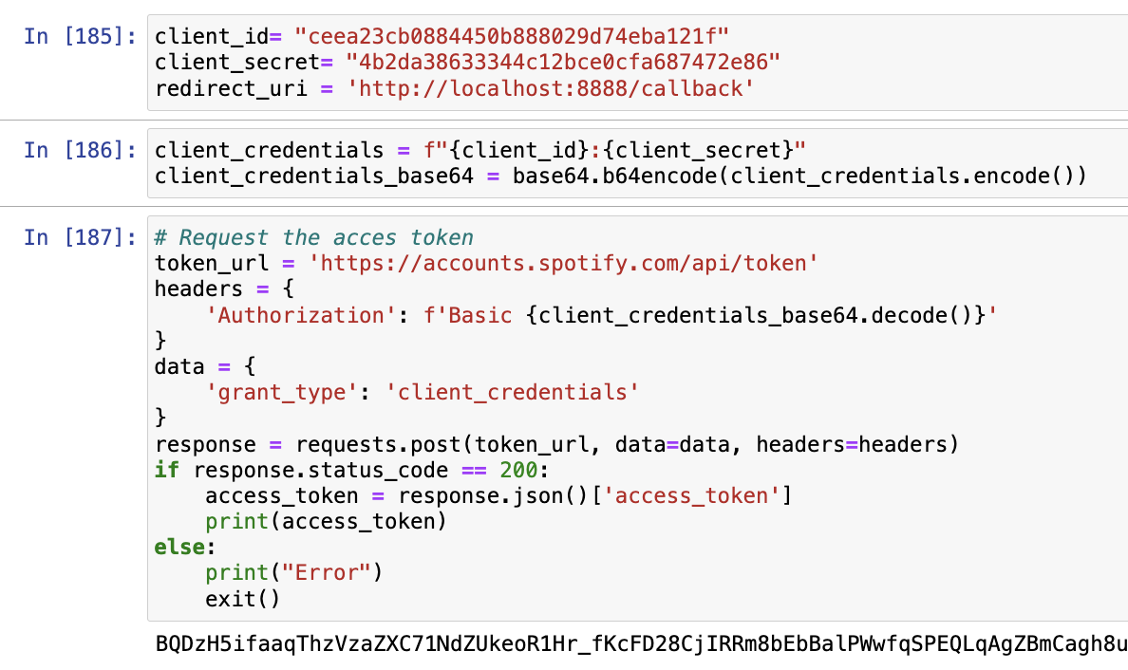
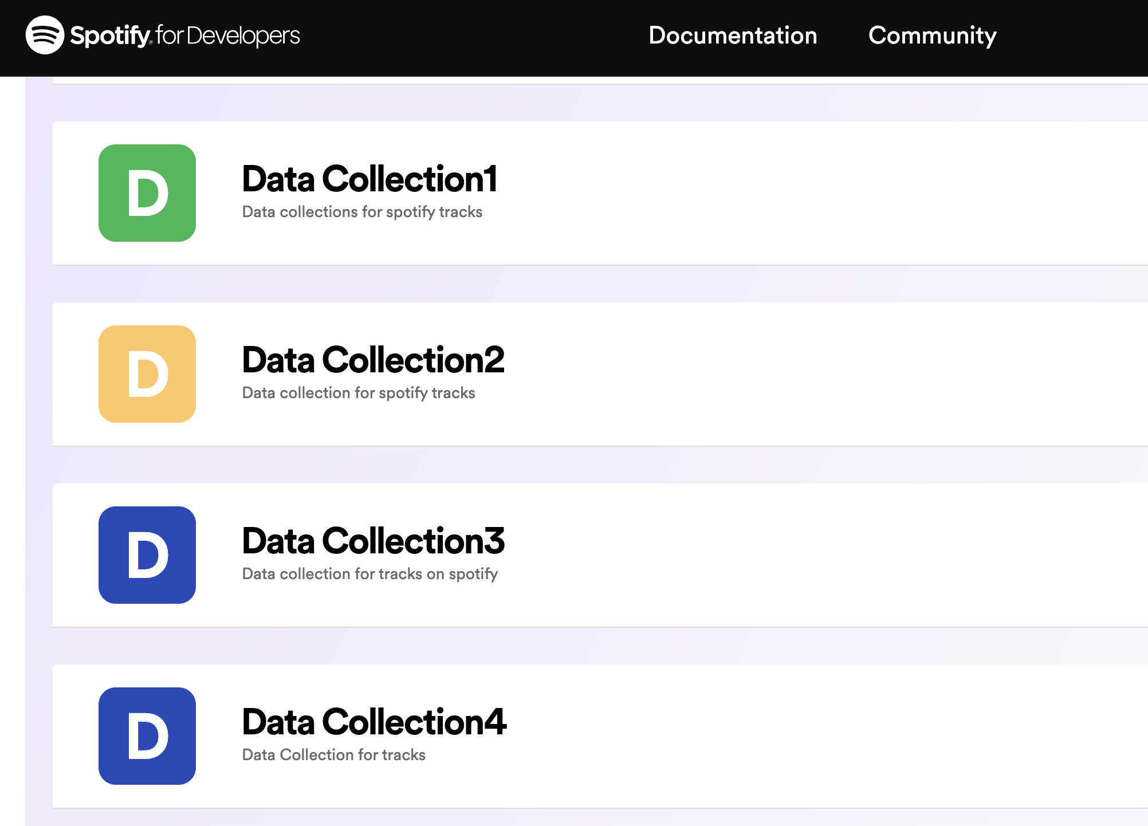
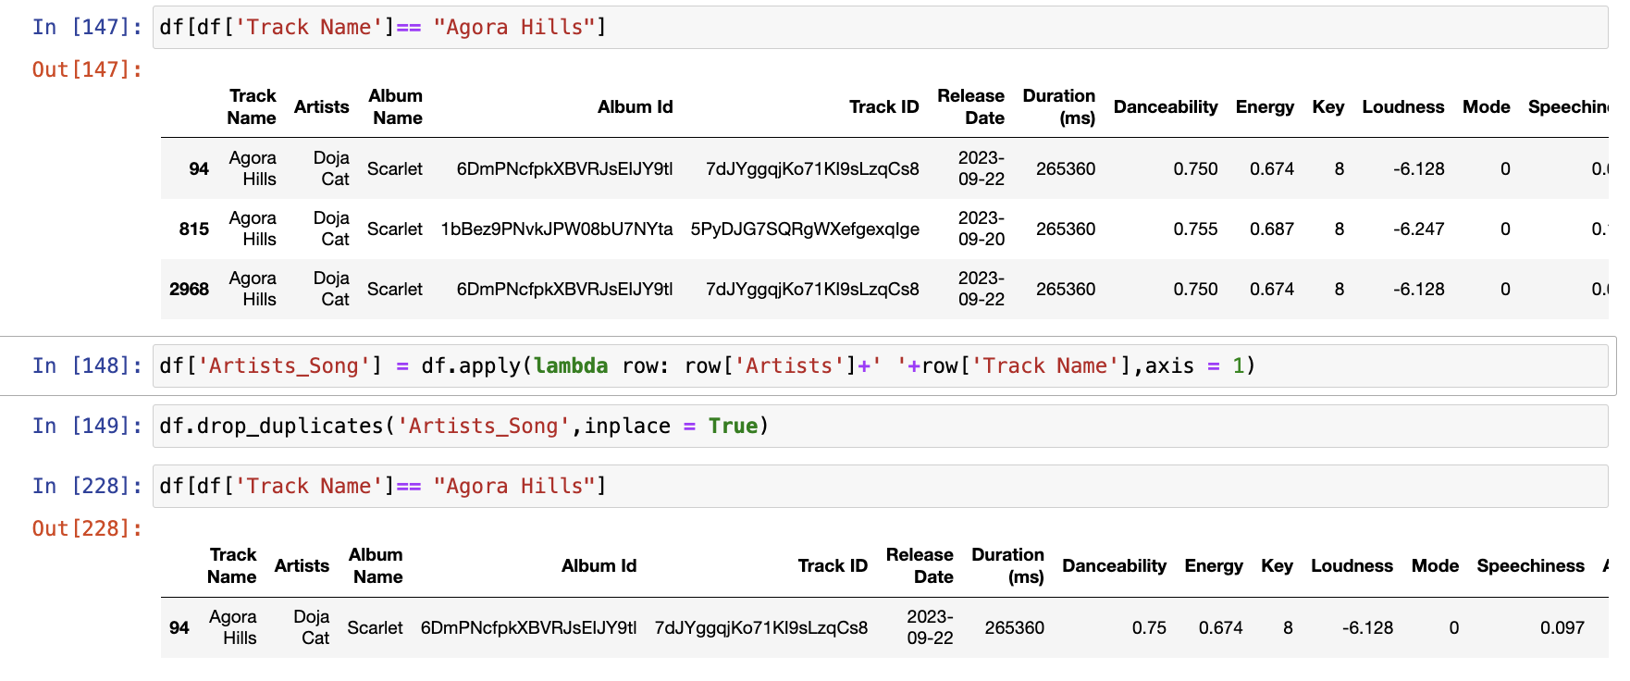
Spotify Web API
Pre-data Collection
Data Collection
Data Preprocessing
- Login in to Spotify Web API page, created an app for client ID and client Secret
-Searched about MACHINE LEARNING, Chose CONTENT-BASED FILTERING Method
-Got ACCESS TOKEN from client ID and client Secret
-From Spotify, got playlist ID
-Access track information from playlist
-Delete all unnecessary column ex. Popularity, Explicit URLs.
-Created Artists_Song column to delete songs with same name same artist but different album ID

Slide 8
3
Our Account Data

Slide 9
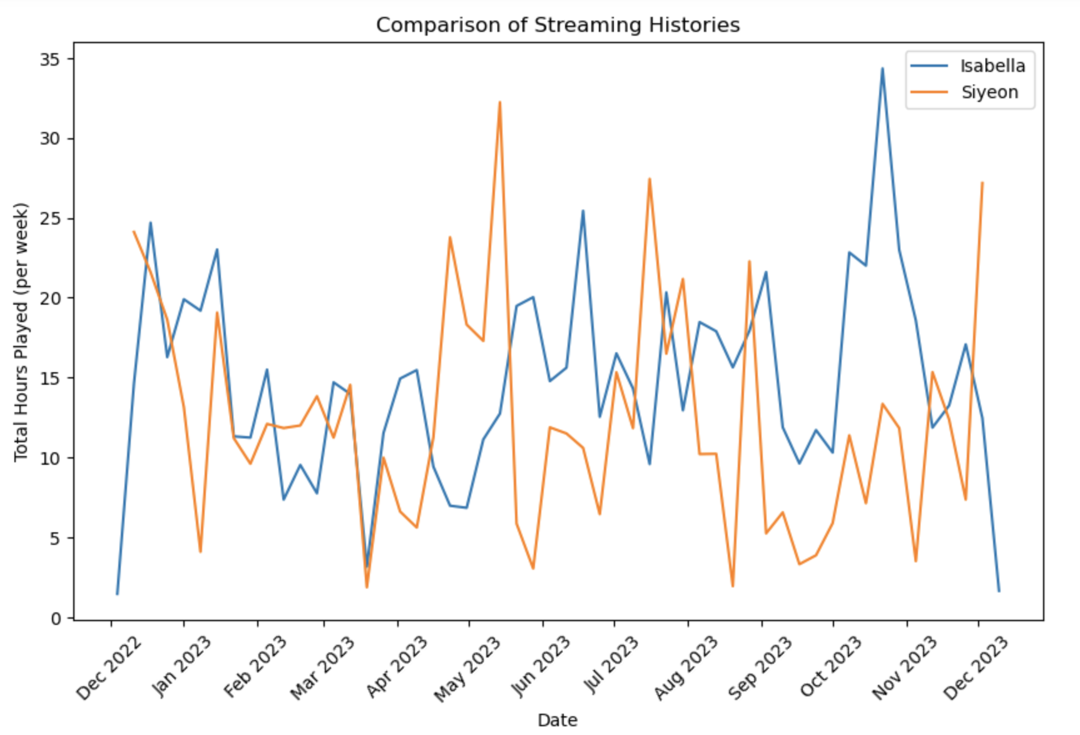
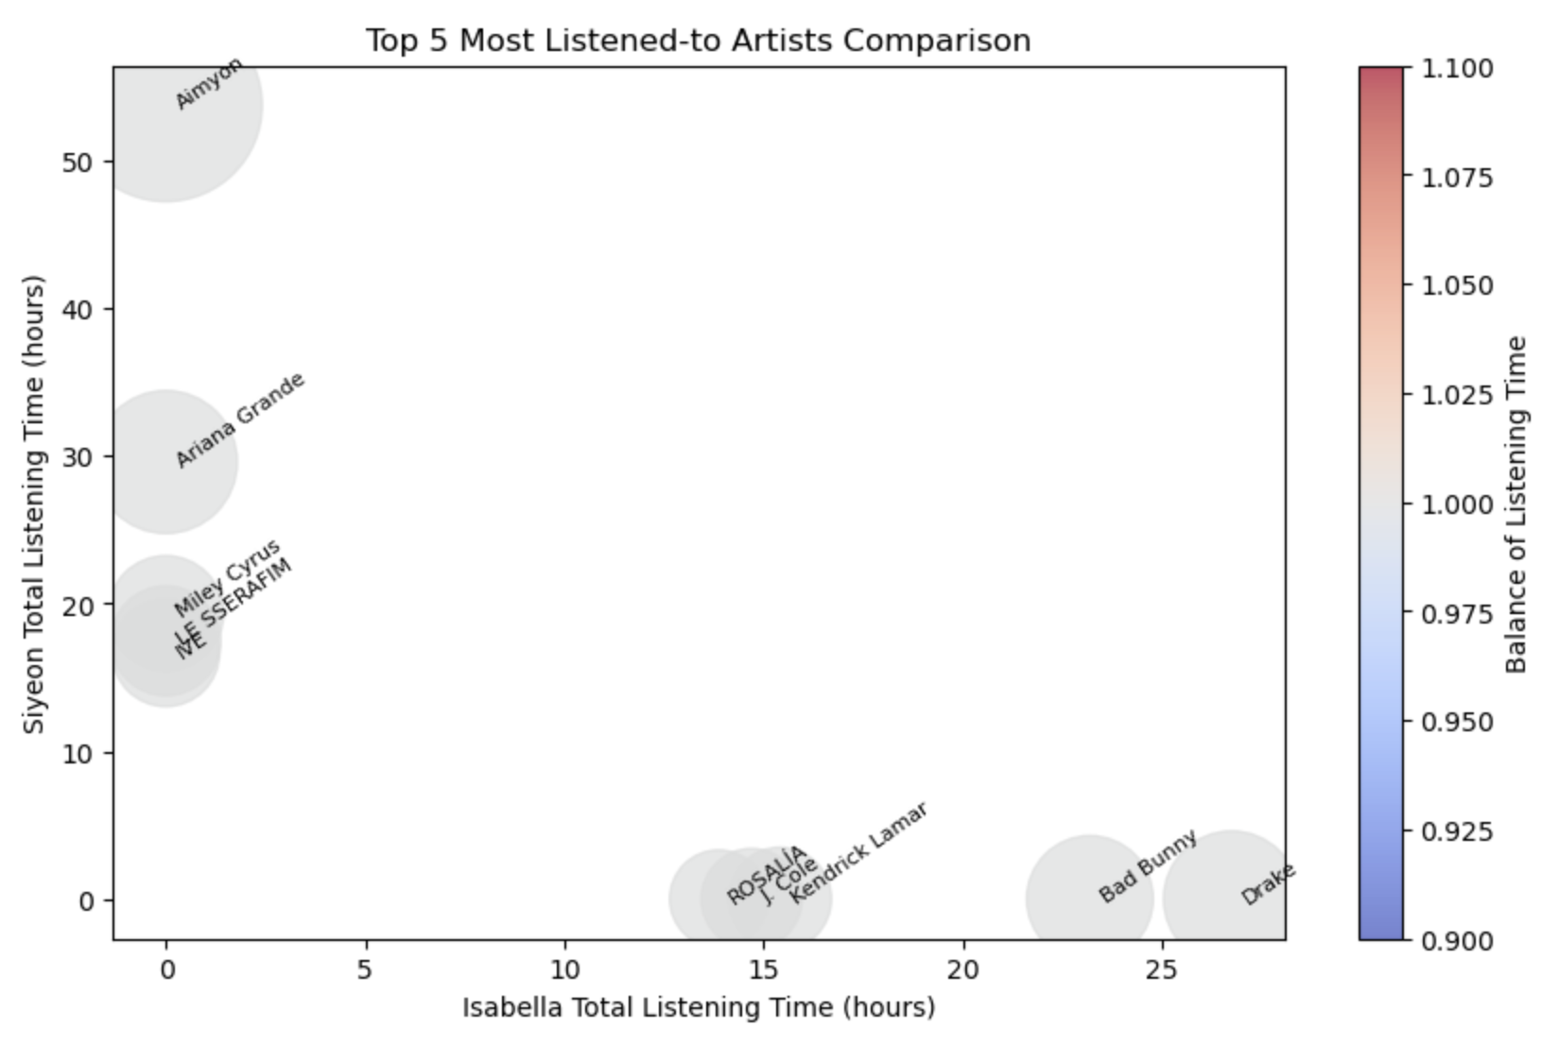
Exploring Our User Data
Notes:
Our user data from spotify included our streaming history from the past year including song titles, artist and album names, how long we streamed each song for. Through creating many visualizations, it was clear there was very little overlap between our streaming history including time and content analysis. Above is a time series analysis comparing our listening activity throughout each month of the past year, and the second figure is a bubble chart showing the relationship between each of our top 5 streamed artists over the past year.

Slide 10
4
Machine Learning

Slide 11


Music Recommendations System
Information filtering system
Collaborative Filtering
Content-Based Filtering
Recommendations based on user behavior or interactions within a system
Attributes or features of items (like music, movies, articles) and user profiles to make recommendations
Recommendation system by Intrinsic Attribute
MinMaxScaler
Cosine Similarity
Notes:
From the track information that we got from the playlist we were able to get features such as danceability, key, loudness. Recommendation system by intrinsic attribute analyze features like tempo, instrumentation, and other audio characteristics, the system identifies patterns and similarities between songs. The machine learning techniques that we used for song recommendation is minmaxscaler and cosine similarity. MinMaxScaler is a preprocessing technique used in machine learning to scale numerical features to a specific range, commonly between 0 and 1.
Cosine similarity is then used to measure the similarity between these feature vectors, allowing the system to recommend songs that share common traits or attributes.
This approach falls under content-based filtering because it relies solely on the content (i.e., music features) of the items (songs) to make recommendations. It doesn't consider user interactions or behaviors but rather focuses on the inherent characteristics of the music itself to suggest similar tracks.

Slide 12
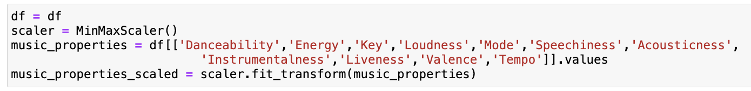
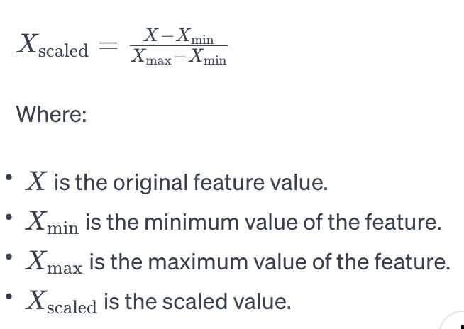
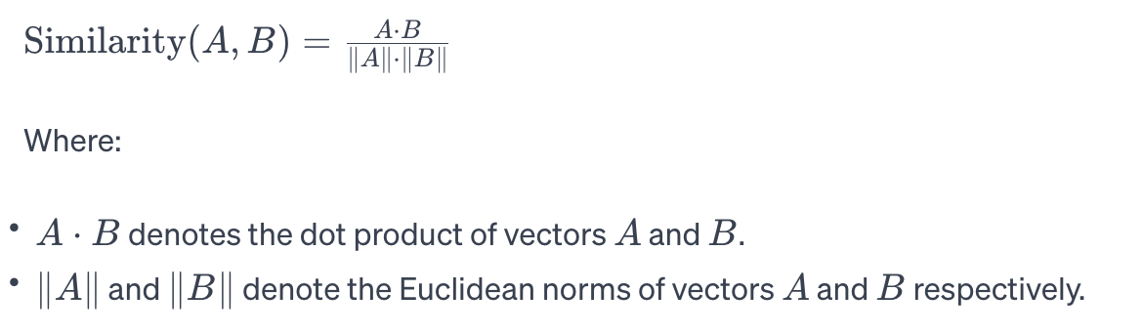
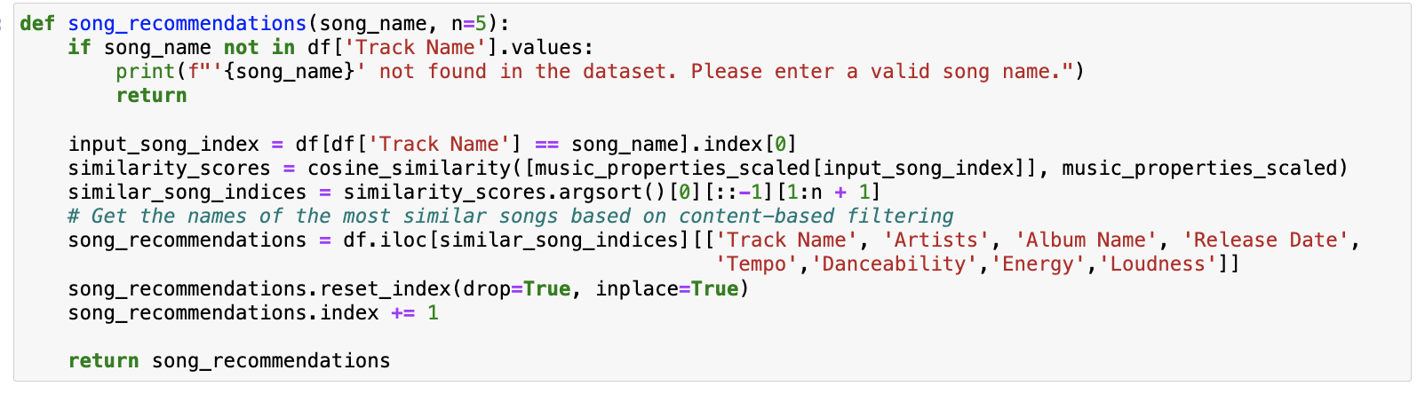
Machine Learning
MinMaxScaler
Cosine Similarity
Preprocessing technique used in Machine Learning to Scale Numerical to a specific range
Measure used to determine how similar two non-zero vectors are irrespective of their magnitude.
Notes:
It works by subtracting the minimum value of the feature and then dividing by the range (difference between the maximum and minimum values). This scaling preserves the relationship between data points while ensuring they fall within a defined range. So, for us we used for preparing the music properties to have values between a specified range. Cosine similarity measure used to determine how similar two non-zero vectors are irrespective of their magnitude we used cosine similarity to compare the similarity between the features of different songs. For our project, cosine similarity is used to compute how similar the music features of different songs are. By representing songs as feature vectors and calculating the cosine similarity between these vectors, we can find songs that are more alike in terms of their musical attributes. This similarity score helps in identifying songs that might be recommended to users who enjoy similar kinds of music.

Slide 13
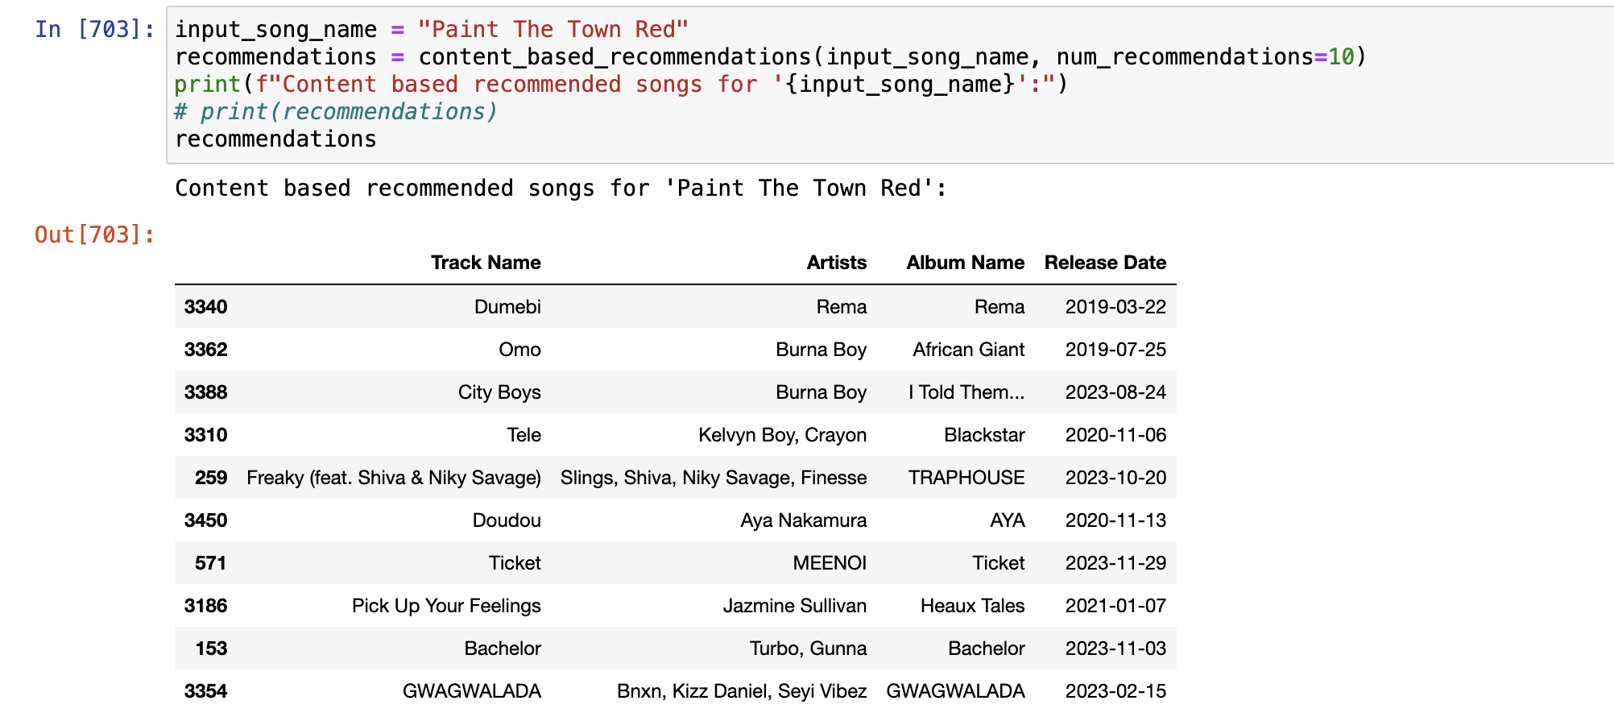
Result

Slide 14
5
Conclusion

Slide 15
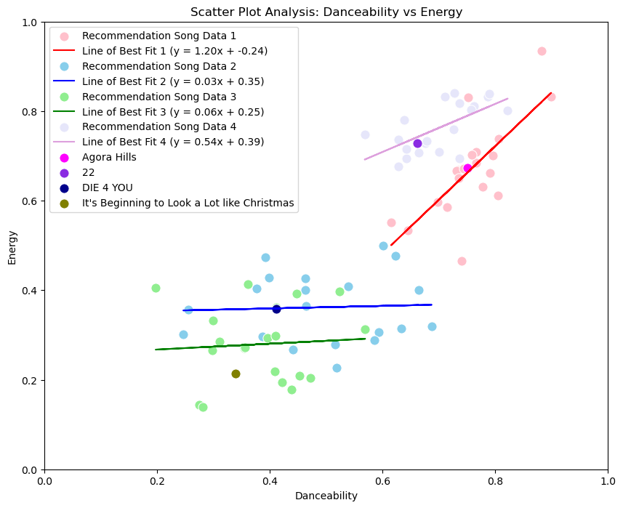
Scatter Plot Analysis
Notes:
We plotted scatter plot for each songs and 20 songs outputted as a song recommendation. It shows every single songs recommended aligned to each danceability and energy feature which shows the song recommendation worked based on the similar music features. Although there’s other music properties such as key, loudness that we didn’t consider on this plot. Still it shows that the songs inputted and the songs outputted aligned each other.

Slide 16
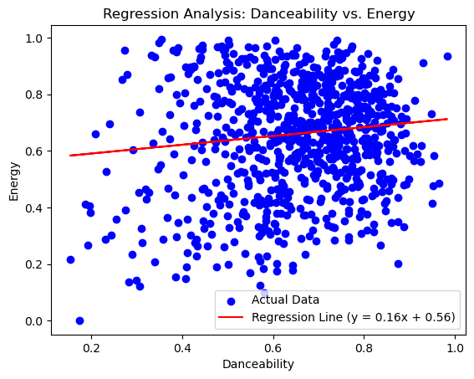
Regression Analysis for our data whole

Slide 17
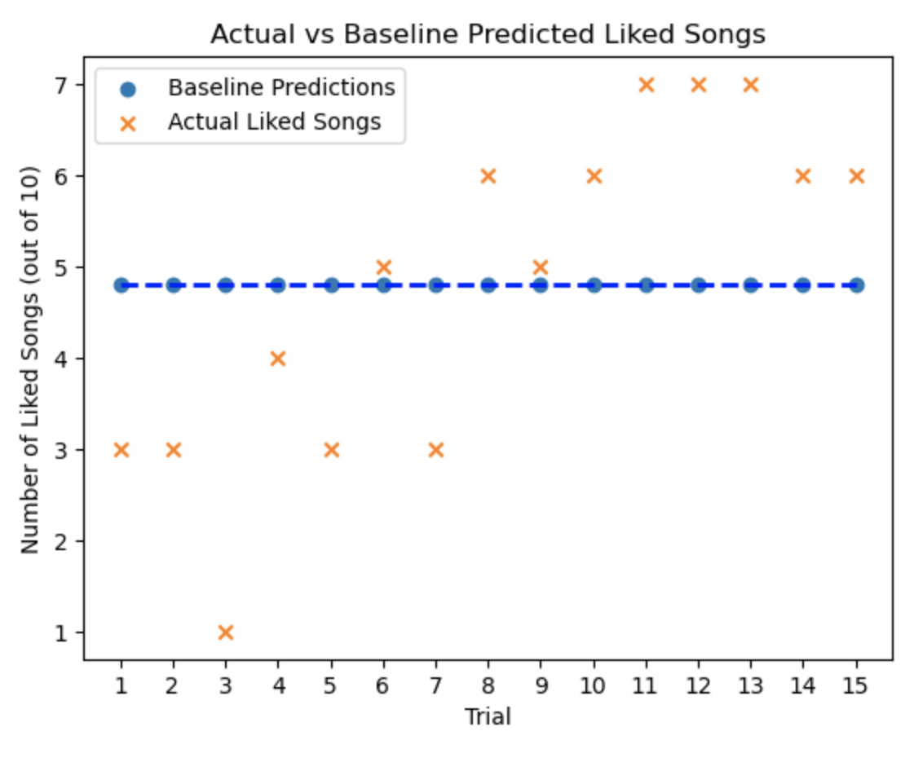
Evaluating Prediction Accuracy
Notes:
We asked people we knew to send us a song request, and generated 10 recommendations for each person. We collected google form responses from 15 people on how many of the songs they like out of the 10 recommended. The baseline model predicts the number of songs that users will like out of the 10 recommendations for all trials. (indicated by blue trend line on graph, the predicted number of liked songs is approximately 5/10). The x markers show the actual number of songs people liked out of the 10 recommended for each of the 15 trials we did. The wide spread of our actual number of liked songs indicates a relatively high mean squared error value for our model. A lower mean square error is the goal, which indicates that our model is making good predictions for songs users will like, but our model accuracy will likely improve for a larger sample size, where our program would be trained and tested with more data.

Slide 18
6
Work Division

Slide 19
Work Division
Isabella
Siyeon
Creating spotify web api application
Obtaining user data through access token requests (and Flask application)
Visualizations for our user data
Evaluating accuracy of our model from trial data
Creating spotify web api application
Data Collection & Data preprocessing
Building Music recommendation model
Visualizations of data

